Slide 1
Si Mineral – MG Silicon – Poly Silicon – Mono Crystal Silicon
By PolyEnergy Semiconductor’s Lin xiao
PolyEnergy Semiconductor Grade Silicon 99.999999999%

Slide 2
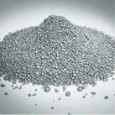
Wacker – Chunk Polysilicon
PolyEnergy Semiconductor Grade Silicon 99.999999999%

Slide 3
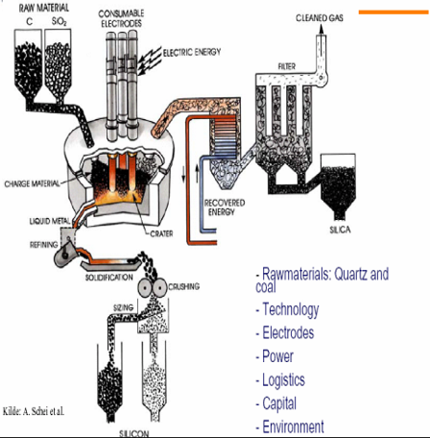
Solar grade Poly Silicon(SG): Si 99.9999% and Semiconductor grade Poly Silicon(EG): Si 99.999999999%.
Metallurgical Silicon
Solar grade or electronic grade silicon - Simens technology
PolyEnergy Semiconductor Grade Silicon 99.999999999%

Slide 4
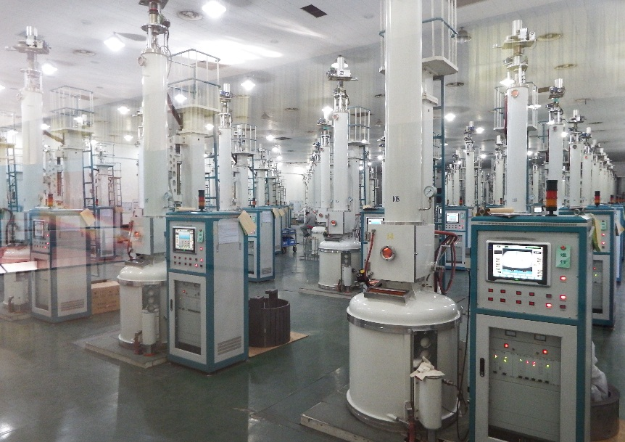
Czochralski Cz- Mono Crystal Silicon ingot Pullers
CZ Crystal Puller
CZ Puller by Poly Energy Semiconductor Factory
PolyEnergy Semiconductor Grade Silicon 99.999999999%

Slide 5
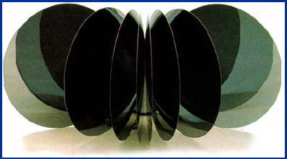
CZ Crystal Puller inside
Mono Crystal Silicon Ingot
PolyEnergy Semiconductor Grade Silicon 99.999999999%

Slide 6
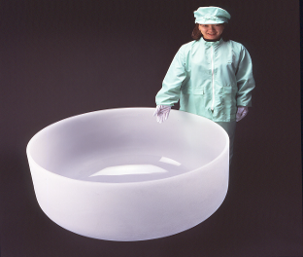
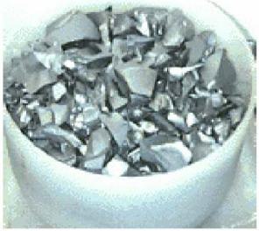
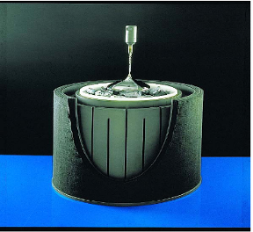
Poly silicon put in (Quartz Crucible)
From Shin-etsu 图 34
Crucible Application 图 35
Crucible Application 图 36
Crucible Size | Wafer Diameter
12" - 14" (mm) 15" - 18" (mm) 20" - 24" (mm) 28" - 32" (mm) | 4“ - 5” (100-125 mm) 5“ - 6” (125 - 150mm) 6“ - 8” (150 - 200mm) 8" - 12" (200 - 300mm) 17’’(450mm, 列入发展规划，2016年规模使用） 27’’（675mm，已列入议程）
PolyEnergy Semiconductor Grade Silicon 99.999999999%

Slide 7
From poly silicon to Silicon Wafer
PolyEnergy Semiconductor Grade Silicon 99.999999999%

